Slide 1
Cornerstone City Church Peninsula Plus Community Hoo Are Ya
7th July 2024

Slide 2


Slide 3


Slide 4
I’m So Blessed
CCLI Song # 7167000
Jonathan Smith | Logan Cain | Madison Cain | Matthew West | Taylor Cain
© All Essential Music; Be Essential Songs; Cashagamble Jet Music; Logan Cain Music; Madison Cain Music; Taylor Cain Music; Combustion Five; Third Story House Music
For use solely with the SongSelect® Terms of Use. All rights reserved. www.ccli.com
CCLI Licence No. 33265

Slide 5
1/10
Trouble knocking at my door today
I won’t let it in
Worry wanna steal my joy away
I won’t let it win

Slide 6
2/10
Cos on my best day I’m a child of God
On my worst day I’m a child of God
Oh everyday is a good day
You’re the reason why

Slide 7
3/10
I’m so blessed, I’m so blessed
Got this heartbeat in my chest
No it doesn’t matter about the rest
If I got You Lord I’m so blessed

Slide 8
4/10
I’m so blessed
Hallelujah I’m blessed
I’m so blessed
Hallelujah I’m blessed

Slide 9
5/10
When I count the problems that I see
Hope looks all but gone
But when I count the ways You’re good to me
You got me counting all day long

Slide 10
6/10
I’m so blessed, I’m so blessed
Got this heartbeat in my chest
No it doesn’t matter about the rest
If I got You Lord I’m so blessed

Slide 11
7/10
Cos on my best day I’m a child of God
On my worst day I’m a child of God
Oh everyday is a good day
You’re the reason why

Slide 12
8/10
I’m so blessed, I’m so blessed
Got this heartbeat in my chest
No it doesn’t matter about the rest
If I got You Lord I’m so blessed
(REPEAT)

Slide 13
9/10
On my best day I’m a child of God
On my worst day I’m a child of God
Oh everyday is a good day
You’re the reason why
(REPEAT)

Slide 14
10/10
I’m so blessed, hallelujah I’m blessed
I’m so blessed, hallelujah I’m blessed
No it doesn’t matter about the rest
If I got You Lord…..
Hallelujah I’m blessed

Slide 15
Sacrifice of Praise
Olumide Iyun

Slide 16
1/4
We bring to you the sacrifice of praise
Give thanks to you with all our voices raised
For you are good
For your mercy never fails

Slide 17
2/4
We celebrate before the throne of grace
For you are great and greatly to be praised
For you are good
For your mercy never fails

Slide 18
3/4
You are good
You are good
You are good
For your mercy never fails
(REPEAT)

Slide 19
4/4
For you are good
For your mercy never fails
(X3)

Slide 20
Goodness Of God
CCLI Song # 7117726
Ben Fielding | Brian Johnson | Ed Cash | Jason Ingram | Jenn Johnson
© 2018 Capitol CMG Paragon (Admin. by Capitol CMG Publishing)
Fellow Ships Music (Admin. by Essential Music Publishing LLC)
So Essential Tunes (Admin. by Essential Music Publishing LLC)
SHOUT! Music Publishing Australia (Admin. by SHOUT! Music Publishing UK)
Bethel Music Publishing (Admin. by Song Solutions)
For use solely with the SongSelect® Terms of Use. All rights reserved. www.ccli.com
CCLI Licence No. 33265

Slide 21
1/6
I love You Lord
Oh Your mercy never fails me
All my days
I've been held in Your hands
From the moment that I wake up
Until I lay my head
I will sing of the goodness of God

Slide 22
2/6
All my life You have been faithful
All my life You have been so so good
With every breath that I am able
I will sing of the goodness of God

Slide 23
3/6
I love Your voice
You have led me through the fire
In darkest night
You are close like no other
I've known You as a father
I've known You as a friend
I have lived in the goodness of God

Slide 24
4/6
All my life You have been faithful
All my life You have been so so good
With every breath that I am able
I will sing of the goodness of God

Slide 25
5/6
Your goodness is running after
It’s running after me
(REPEAT)
With my life laid down
I’m surrendered now
I give You everything
Your goodness is running after
It's running after me

Slide 26
6/6
All my life You have been faithful
All my life You have been so so good
With every breath that I am able
I will sing of the goodness of God

Slide 27
1/1
I see the evidence of Your goodness
All over my life
All over my life
I see Your promises in fulfilment
All over my life
All over my life

Slide 29
He Knows My Name
CCLI Song # 2151368
Tommy Walker
© 1996 Universal Music - Brentwood Benson Songs
For use solely with the SongSelect® Terms of Use. All rights reserved. www.ccli.com
CCLI Licence No. 33265

Slide 30
1/4
I have a Maker
He formed my heart
Before even time began
My life was in His hand

Slide 31
2/4
He knows my name
He knows my every thought
He sees each tear that falls
And hears me when I call

Slide 32
3/4
I have a Father
He calls me His own
He'll never leave me
No matter where I go

Slide 33
4/4
He knows my name
He knows my every thought
He sees each tear that falls
And hears me when I call

Slide 34
No Longer Slaves CCLI Song # 7030123
Brian Johnson | Joel Case | Jonathan David Helser
© 2014 Bethel Music Publishing (Admin. by Song Solutions)
For use solely with the SongSelect® Terms of Use. All rights reserved. www.ccli.com
CCLI Licence No. 33265

Slide 35
1/5
You unravel me with a melody You surround me with a song Of deliverance from my enemies Till all my fears are gone

Slide 36
2/5
I'm no longer a slave to fear I am a child of God I'm no longer a slave to fear I am a child of God

Slide 37
3/5
From my Mother's womb You have chosen me Love has called my name I've been born again into Your family Your blood flows through my veins

Slide 38
4/5
I'm no longer a slave to fear I am a child of God I'm no longer a slave to fear I am a child of God

Slide 39
5/5
You split the sea so I could walk right through it My fears were drowned in perfect love You rescued me so I could stand and sing I am a child of God

Slide 41


Slide 42
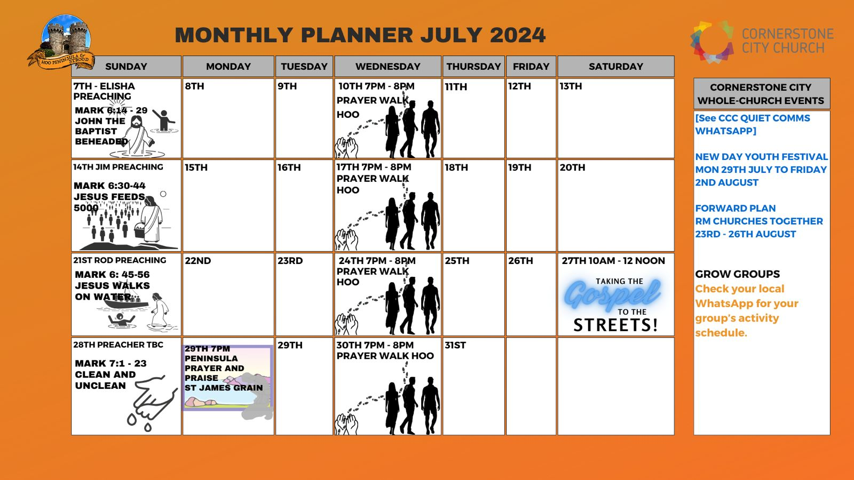

Slide 43
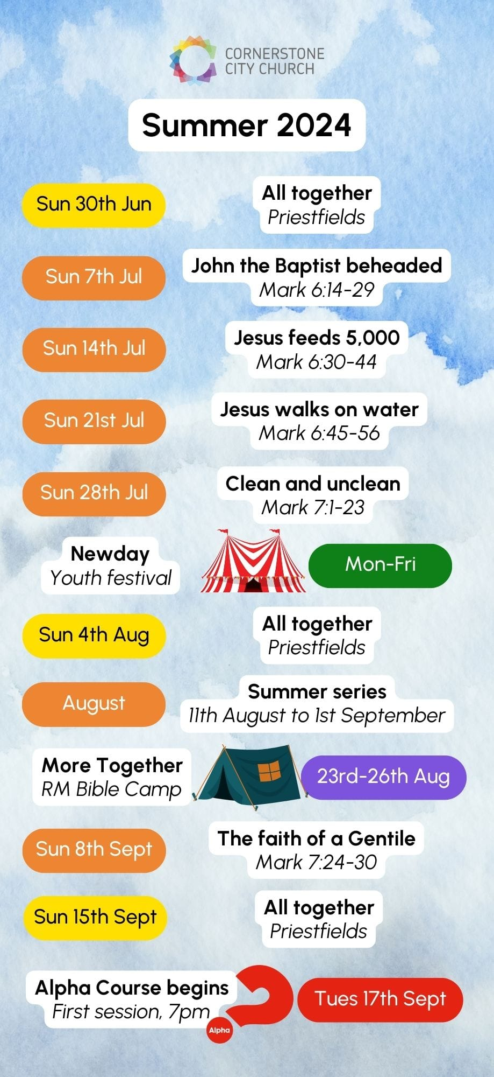

Slide 44


Slide 45


Slide 46


Slide 47
Build My Life
CCLI Song # 7070345
Brett Younker | Karl Martin | Kirby Kaple | Matt Redman | Pat Barrett
© 2016 Capitol CMG Genesis (Admin. by Capitol CMG Publishing)
Housefires Sounds (Admin. by Capitol CMG Publishing)
sixsteps Music (Admin. by Capitol CMG Publishing)
Vamos Publishing (Admin. by Capitol CMG Publishing)
worshiptogether.com songs (Admin. by Capitol CMG Publishing)
Said And Done Music (Admin. by Integrity Music Ltd)
Thankyou Music (Admin. by Integrity Music Ltd)
Martin, Karl Andrew (Admin. by Sentric Music)
Bethel Music Publishing (Admin. by Song Solutions)
Kaple Music (Admin. by Song Solutions)
For use solely with the SongSelect® Terms of Use. All rights reserved. www.ccli.com
CCLI Licence No. 33265

Slide 48
1/4
Worthy of ev'ry song we could ever sing
Worthy of all the praise we could ever bring
Worthy of ev'ry breath we could ever breathe
We live for You

Slide 49
2/4
Jesus the name above ev'ry other name
Jesus the only one who could ever save
Worthy of ev'ry breath we could ever breathe
We live for You
We live for You

Slide 50
3/4
Holy there is no one like You
There is none beside You
Open up my eyes in wonder and show me who You are
And fill me with Your heart
And lead me in Your love to those around me

Slide 51
4/4
I will build my life upon Your love
It is a firm foundation
I will put my trust in You alone
And I will not be shaken

Slide 52
2 Corinthians 14 May the grace of the Lord Jesus Christ, and the love of God, and the fellowship of the Holy Spirit be with you all

